Slide 1
Fundamental Electrical Concepts
Charge, Current, Voltage,
Power and Energy
Chapter 2, sec. 2.2 & 2.3

Slide 2
Electric Charge (Q)
Characteristic of subatomic particles that determines their electromagnetic interactions
An electron has a -1.602∙10⁻¹⁹ Coulomb charge
The rate of flow of charged particles is called current

Slide 3
Current (I)
Current = (Number of electrons that pass in one second) ∙ (charge/electron)
  -1 ampere = (6.242∙10¹⁸ e/sec) ∙(-1.602 10⁻¹⁹Coulomb/e)
  Notice that an ampere = Coulomb/second
The negative sign indicates that the current inside is actually flowing in the opposite direction of the electron flow
Electrons
Current

Slide 4
Current
i = dq/dt – the derivitive or slope of the charge when plotted against time in seconds
Q = ∫ i ∙ dt – the integral or area under the current when plotted against time in seconds
Current
amps
4
3
2
1
Q delivered in 0-5 sec= 12.5 Coulombs
5 sec

Slide 5
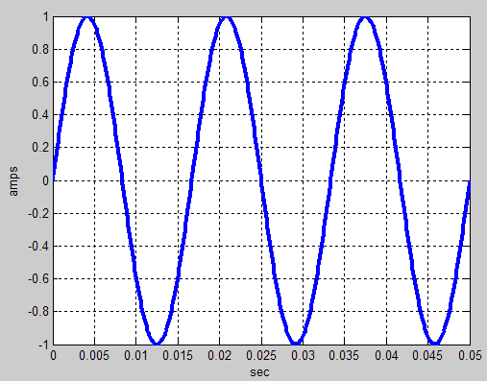
AC and DC Current
DC Current has a constant value
AC Current has a value that changes sinusoidally
Notice that AC current
changes in value and
direction
No net charge is
transferred

Slide 6
Why Does Current Flow?
A voltage source provides the energy (or work) required to produce a current
  Volts = joules/Coulomb = dW/dQ
A source takes charged particles (usually electrons) and raises their potential so they flow out of one terminal into and through a transducer (light bulb or motor) on their way back to the source’s other terminal

Slide 7
Voltage
Voltage is a measure of the potential energy that causes a current to flow through a transducer in a circuit
Voltage is always measured as a difference with respect to an arbitrary common point called ground
Voltage is also known as electromotive force or EMF outside engineering

Slide 8
A Circuit
Current flows from the higher voltage terminal of the source into the higher voltage terminal of the transducer before returning to the source
I
+ Transducer -
Voltage
The source expends
energy & the transducer
converts it into
something useful
+
Source
Voltage
-
I

Slide 9
Passive Devices
A passive transducer device functions only when energized by a source in a circuit
  Passive devices can be modeled by a resistance
Passive devices always draw current so that the highest voltage is present on the terminal where the current enters the passive device
+ V > 0 -
I > 0
Notice that the voltage is
measured across the device
Current is measured
through the device

Slide 10
Active Devices
Sources expend energy and are considered active devices
Their current normally flows out of their highest voltage terminal
Sometimes, when there are multiple sources in a circuit, one overpowers another, forcing the other to behave in a passive manner

Slide 11
Power
The rate at which energy is transferred from an active source or used by a passive device
P in watts = dW/dt = joules/second
P= V∙I = dW/dQ ∙ dQ/dt = volts ∙ amps = watts
W = ∫ P ∙ dt – so the energy (work in joules) is equal to the area under the power in watts plotted against time in seconds

Slide 12
Conservation of Power
Power is conserved in a circuit - ∑ P = 0
We associate a positive number for power as power absorbed or used by a passive device
A negative power is associated with an active device delivering power
I
If I=1 amp
V=5 volts
Then passive
P=+5 watts
(absorbed)
If I= -1 amp
V=5 volts
Then active
P= -5 watts
(delivered)
If I= -1 amp
V= -5 volts
Then passive
P=+5 watts
(absorbed)
+
V
-

Slide 13
Example
A battery is 11 volts and as it is charged, it increases to 12 volts, by a current that starts at 2 amps and slowly drops to 0 amps in 10 hours (36000 seconds)
The power is found by multiplying the current and voltage together at each instant in time
In this case, the battery (a source) is acting like a passive device (absorbing energy)

Slide 14
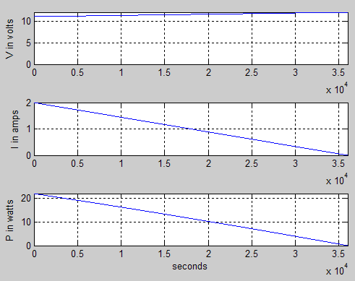
Voltage, Current & Power

Slide 15
Energy
The energy is the area under the power curve
  Area of triangle = .5 ∙ base ∙ height
  W=area= .5 ∙ 36000 sec. ∙ 22 watts = 396000 J.
  W=area= .5 ∙ 10 hr. ∙ .022 Kw. = 110 Kw.∙hr
So 1 Kw.∙hr = 3600 J.
Since 1 Kw.∙hr costs about $0.10, the battery costs $11.00 to charge

Slide 16
Homework Application
Calculate the cost per mile of a plug-in electric vehicle with the following parameters
  A 120 volt source is used for 6 hours at a current of 20 amps at a cost of $0.10/KWhr each night to charge the battery pack in the vehicle
  The car will operate for 50 miles on a charge
Determine the cost per mile for a gas-powered vehicle getting 25 mpg using $3.75 per gal. gas
How much would you save in fuel cost per year if you averaged 40 plug-in miles per day

